Slide 1
Work Opportunity Tax Credit Maximize hiring investment
Notes:
Title page to include presentation title/topic, speaker, date etc.

Slide 2
About CMS
CMS has provided WOTC administration services since 1997.
20+ years of experience in Employment Tax Credits and HR & Payroll Technology
Developed a secure online WOTC portal in 2015 to help customers automate WOTC processing and data collection.
Innovator in online technology to automate the complete hiring process with WOTC portal, web based recruiting and electronic onboarding products iRecruit and iConnect.
Believes in a customer-centric approach to maximize your return on investment.
Notes:
A timed course agenda is a NASBA requirement. The modules listed should have corresponding ‘section break’ slides (slides with all blue background) throughout the presentation. If participant materials are electronic, these modules/section breaks will be the titles of the bookmarked sections of the adobe (PDF) participant guide.
You should add or delete rows in the table as necessary (select a row and right-click) to fit the specific course.

Slide 3
Agenda
History of WOTC Tax Credits
What is WOTC?
How does WOTC benefit business?
Who is eligible?
How much can be saved?
What is the process?
What is advantage of 3rd Party
Getting started…
Notes:
A timed course agenda is a NASBA requirement. The modules listed should have corresponding ‘section break’ slides (slides with all blue background) throughout the presentation. If participant materials are electronic, these modules/section breaks will be the titles of the bookmarked sections of the adobe (PDF) participant guide.
You should add or delete rows in the table as necessary (select a row and right-click) to fit the specific course.

Slide 4
WOTC Objectives
The program is intended to entice businesses to hiring members of hard-to-employ target groups--predominantly the economically disadvantaged--in exchange for Federal tax credits.
With the objective of individuals to:
Become employed
Earn a steady income
Become contributing taxpayers

Slide 5
History of Employment Tax Credits
1978 - Targeted Jobs Tax Credit (TJTC), Economical Disadvantage
1981 – Reagan administration - The Economic Recovery Act
1983 – Reagan administration expanded program “The Employment Act of 1983”. It provides appropriate incentives for employers to hire the long-term unemployed.
1994 - The Joint Committee on Taxation estimates that the TJTC program will cost taxpayers nearly $300 million.
2005 - Congress passed and the President signed the Katrina Emergency Tax Relief Act for EE’s displaced from the hurricane.

Slide 6
Current Legislation
New Legislation:
President Obama signed the Omnibus Spending Bill H.R. 2029 and the PATH Act (Protecting Americans from Tax Hikes Act of 2015) into law on December 18, 2015, extending the Work Opportunity Tax Credit (WOTC) Program for another five years. Businesses will now be able to take advantage of WOTC through 12/31/19.
The Work Opportunity Tax Credit (WOTC) is a federal income tax benefit administered by the U.S. Department of Labor (DOL) for employers who hire individuals from specified target populations.
Annually employers claim about $2 billion in tax credits each year under the WOTC program. There is no limit on the number of individuals an employer can hire to qualify to claim the tax credit.
Eligible employees must be certified and claims filed within “28 days” of hiring date.
Notes:
A timed course agenda is a NASBA requirement. The modules listed should have corresponding ‘section break’ slides (slides with all blue background) throughout the presentation. If participant materials are electronic, these modules/section breaks will be the titles of the bookmarked sections of the adobe (PDF) participant guide.
You should add or delete rows in the table as necessary (select a row and right-click) to fit the specific course.

Slide 7
Unique Characteristics of WOTC
Under IRS Legislation
but
Administered by the DOL
and
Empowerment & Rural Renewal zones managed by the HUD Legislation

Slide 8
What Companies are Eligible?
Companies:
C Corps
S Corps
LLC’s
Non Profit 501c’s who hire veterans under the Vow to Hire Heroes Act.

Slide 9
Overview of Targeted Groups:
Qualified Temporary Assistance for Needy Families (TANF) Short-Term & Long-Term
Qualified Veteran- see next slide
Qualified Ex-Felon
Designated Community Resident (Age 18- 39) (Federal Empowerment Zones & Rural Renewal Counties)
Vocational Rehabilitation Referral
Summer Youth Employee (Age 16-17 / DCR / 5/1 - 9/15)
Supplemental Nutrition Assistance Program (SNAP) (Age 18- 39)
Supplemental Security Income (SSI) Recipient
Long-Term Unemployment Recipients

Slide 10
SNAP Recipients
SUPPLEMENTAL NUTRITION ASSISTANCE PROGRAM
( Data as of August 4, 2017 )
Fiscal | PARTICIPATION |  | BENEFIT | AVERAGE MONTHLY BENEFIT
Year | Persons | Households | COSTS | Per Person | Per Household
ANNUAL SUMMARY
FY 2017 | 42,489,495 | 21,001,853 | 42,447,086,150 | 124.88 | 252.64
FY 2016 | 44,219,363 | 21,777,938 | 66,539,351,219 | 125.40 | 254.61
FY 2015 | 45,766,672 | 22,522,261 | 69,645,138,228 | 126.81 | 257.69
FY 2014 | 46,663,872 | 22,744,054 | 69,998,835,569 | 125.01 | 256.47
There are 42,489,495 persons in the United States receiving Supplemental Nutrition Assistance benefits.
That is 1 in 7 people nationwide.
Source: https://www.fns.usda.gov/pd/supplemental-nutrition-assistance-program-snap

Slide 11
New Targeted Groups:
New - Long-Term Unemployment Recipient
Among the unemployed, the number of long-term unemployed (those jobless for 27 weeks or more) was at 1.8 million in July 2017 and accounted for 25.9% percent of the unemployed.
Source: https://www.bls.gov/news.release/pdf/empsit.pdf

Slide 12
Qualified Veterans

Slide 13
Qualified Veterans
In 2016 there were 453,000 unemployed veterans in the United States.
4% percent were age 18 to 24
36% percent were age 25 to 44
60% percent were age 45 and over
Veterans with a service-connected disability had an unemployment rate of 4.8% percent in August 2016, about the same as veterans with no disability (4.7 percent).
Source: https://www.bls.gov/news.release/vet.nr0.htm

Slide 14
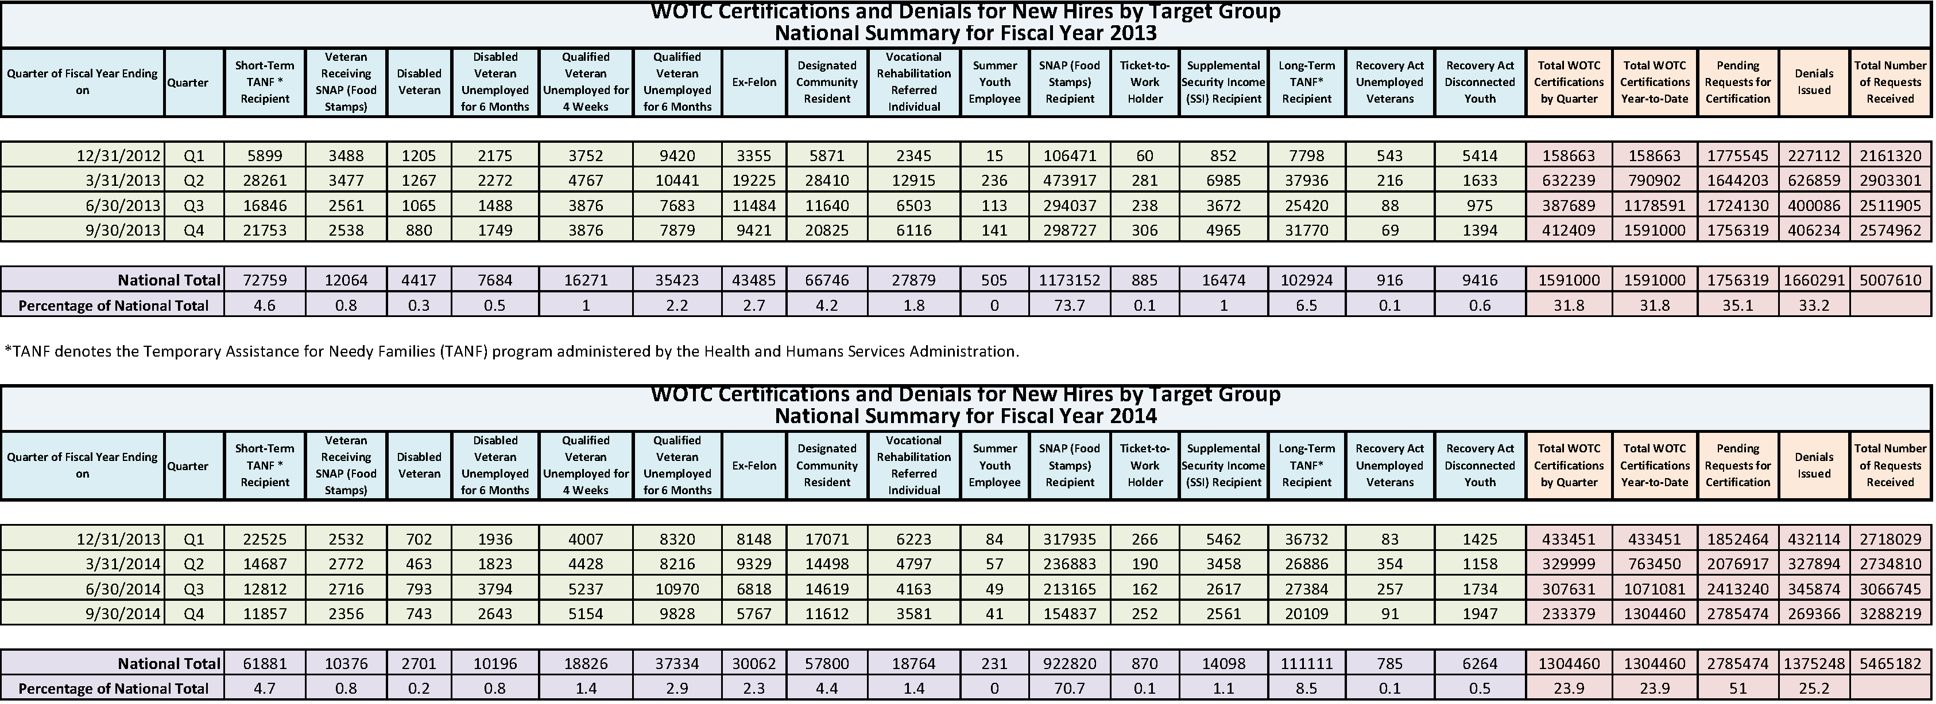
Statistics
*2014 is the most recent year available. Although some states are starting to provide data individually. Tax credits estimated between 1.8 – 2.0 Billion Dollars per year.
Source: https://www.doleta.gov/business/incentives/opptax/pdf/WOTC_NationalCertifications_TargetGroup_FY20132014.pdf

Slide 15
Who is not eligible?
Family members
Rehires – Only eligible for new hires

Slide 16
WOTC Workflow
NEW HIRES
WOTC APPLICATIONS
REVIEW &
SUBMIT TO SWA
TRACK HOURS
& WAGES
CERTIFICATIONS

Slide 17
Screen New Hires on IRS Form 8850

Slide 18
Screen New Hires on DOL Form 9061

Slide 19
How Do you compute the Tax Credit?
Calculating the Tax Credit
The tax credit amount under the WOTC program depends on employee retention. For most target groups, WOTC is based on qualified wages paid to the employee for the first year of employment. For Long-Term Family Assistance recipients, WOTC is based on a two-year retention period.
There are bench marks:
The qualified individual must work a minimum 120 hours, to receive 25% first year wages maximum tax credit.
EE works 125 hours @ $10.00 = $1,250.00 – Tax Credit is $312.50
Individual works 400 hours, tax credit goes to 40% of the individual's first year wages, up to the maximum tax credit
EE works 410 Hours @ $10.00 = $4,100.00 - Tax Credit is $1,640.00
EE works 620 hours @ $10.00 =$6,200.00 – Tax Credit max’s out at $40% of first $6K = $2,400.00
Only for the Long-term Temporary Assistance for Needy Families (TANF) target group, the credit is available for a 2nd year of employment, Goal is to keep people in the work-force.
In the first year, employers may claim a tax credit equal to:
25% of the first-year wages, up to the maximum tax credit, if the individual works at least 120 hours
40% of the first-year wages, up to the maximum tax credit, if the individual works at least 400 hours
In the second year, employers may claim a tax credit equal to:
25% of the second-year wages, up to the maximum tax credit, if the individual works at least 120 hours
50% of the second-year wages, up to the maximum tax credit, if the individual works at least 400 hours

Slide 20
WOTC Calculation Chart

Slide 21
WOTC Calculation Chart

Slide 22
Sample Calculation
Sample Benefits Calculation for WOTC screening
Range of Effort | From |  | To
W2 Hires per Year | 25 |  | 50 |  | 100 |  | 150 |  | 250 |  | 500 | 1,000
Screening Compliance | 95% |  | 95% |  | 95% |  | 95% |  | 95% |  | 95% | 95%
Actual Screens | 24 |  | 48 |  | 95 |  | 143 |  | 238 |  | 475 | 950
Initially Eligible % | 17% |  | 17% |  | 17% |  | 17% |  | 17% |  | 17% | 17%
Eligibles | 4 |  | 8 |  | 16 |  | 24 |  | 40 |  | 81 | 162
Form Compliance | 95% |  | 95% |  | 95% |  | 95% |  | 95% |  | 95% | 95%
Timely Submitted Forms | 4 |  | 8 |  | 15 |  | 23 |  | 38 |  | 77 | 153
Percent Certified | 95% |  | 95% |  | 95% |  | 95% |  | 95% |  | 95% | 95%
Certifications Secured | 4 |  | 7 |  | 15 |  | 22 |  | 36 |  | 73 | 146
Average Credit | $1,500 |  | $1,500 |  | $1,500 |  | $1,500 |  | $1,500 |  | $1,500 | $1,500
Projected WOTC | $5,466 |  | $10,932 |  | $21,863 |  | $32,795 |  | $54,658 |  | $109,315 | $218,631

Slide 23
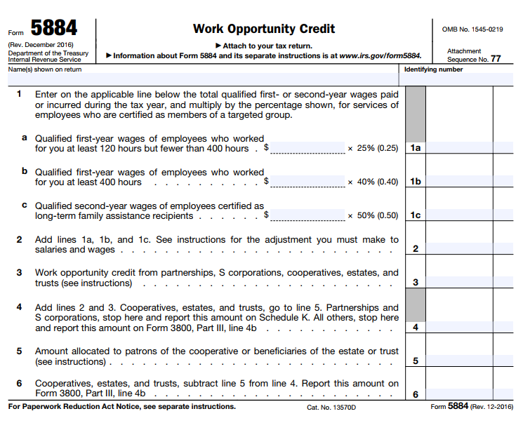
Claim your Tax Credits on IRS 5884

Slide 24
IRS General Business Tax Credit Guidelines
Legislation of General Business Tax Credits for Form 3800.
Carryback and Carryforward of Unused Credit
If you have an unused credit after carrying it back 1 year, carry it forward to each of the 20 tax years after the year of the credit.
There is an order in which you apply the tax credits. Review Page 2 of the IRS 3800 guidelines.

Slide 25
Why Use a 3rd Party Service?
It’s a bit complex, it requires Accounting, HR & Payroll to all be involved.
The IRS 8850 ask some very sensitive questions many companies do not want to ask. I.E. Are you receiving SNAP?
Legislation has been uncertain stops & starts make it confusing.
The administrative process is a burden.

Slide 26
CMS Screening Options
As Easy As 1, 2, 3
1-800 Call center
CMS WOTC Web Portal
Paper-based (email, fax, or mail)
or
Combination of above - our centralized system combines all methods into 1 tracking system
Note: The IRS accepts electronic signatures for the WOTC forms!! This means no forms need to be mailed in, so using the WOTC web portal & call center is easier & faster.

Slide 27
Call Center Approach
1-800 # with Minimal burden placed on hiring staff
Give employee three minutes of privacy
Our Call Center is also bi-lingual
Impartial conversation
Staff congratulates new hire, informs that screening is conducted “per government requirements”
Confirmation number is provided to return to hiring manager – Ensure we screen all new employees
If qualified, form 8850 is generated and e-signed by employee – Virtually no forms to submit!

Slide 28
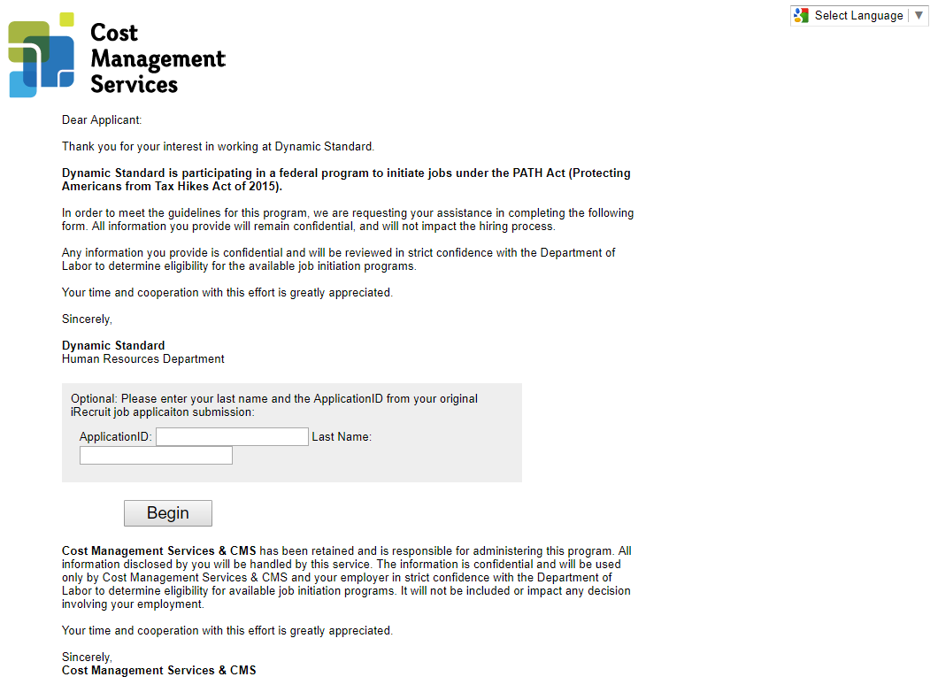
CMS WOTC Web Portal
-5 Minutes to complete
Electronic Signature
No Forms to send in!
Monitor in Real-Time

Slide 29
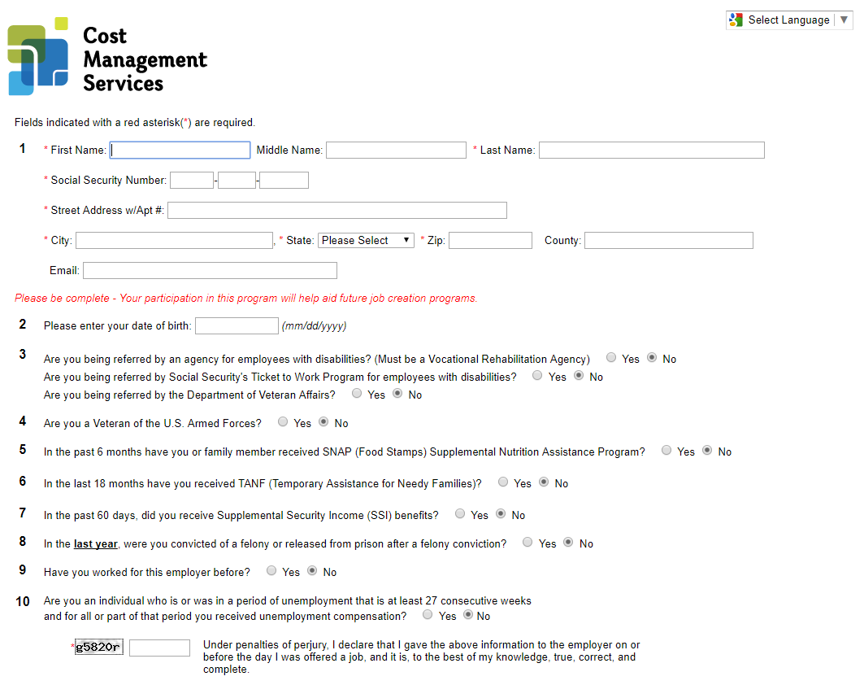
CMS WOTC Web Portal
-5 Minutes to complete
Simple, Yes/No Response
Electronic Signature
No Forms to send in!
Monitor in Real-Time

Slide 30
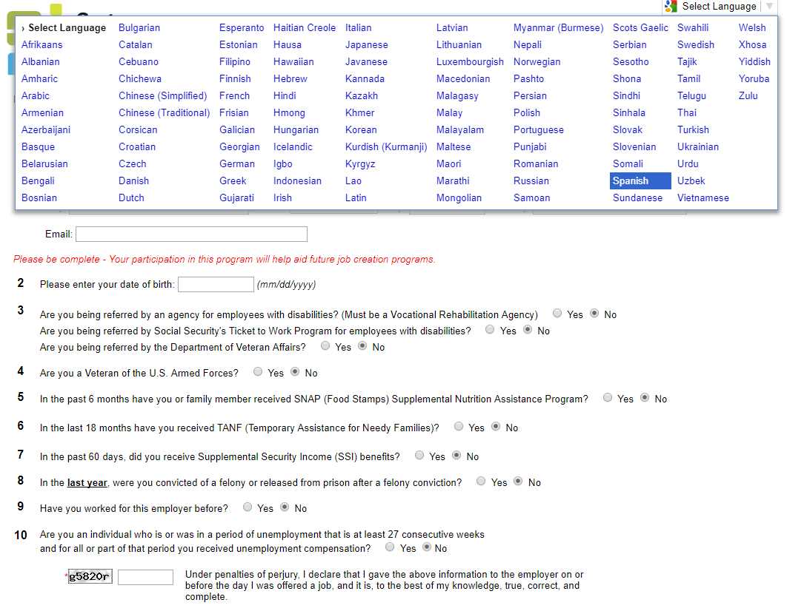
CMS WOTC Web Portal
Reduce Barriers with Translation tools.
100+ Languages

Slide 31
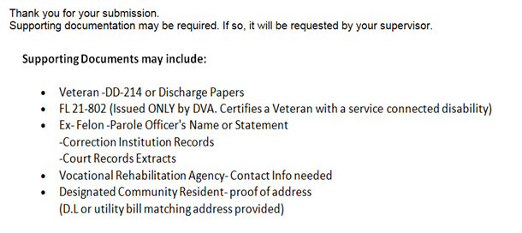
CMS WOTC Web Portal
Supporting Documents May be Requested

Slide 32
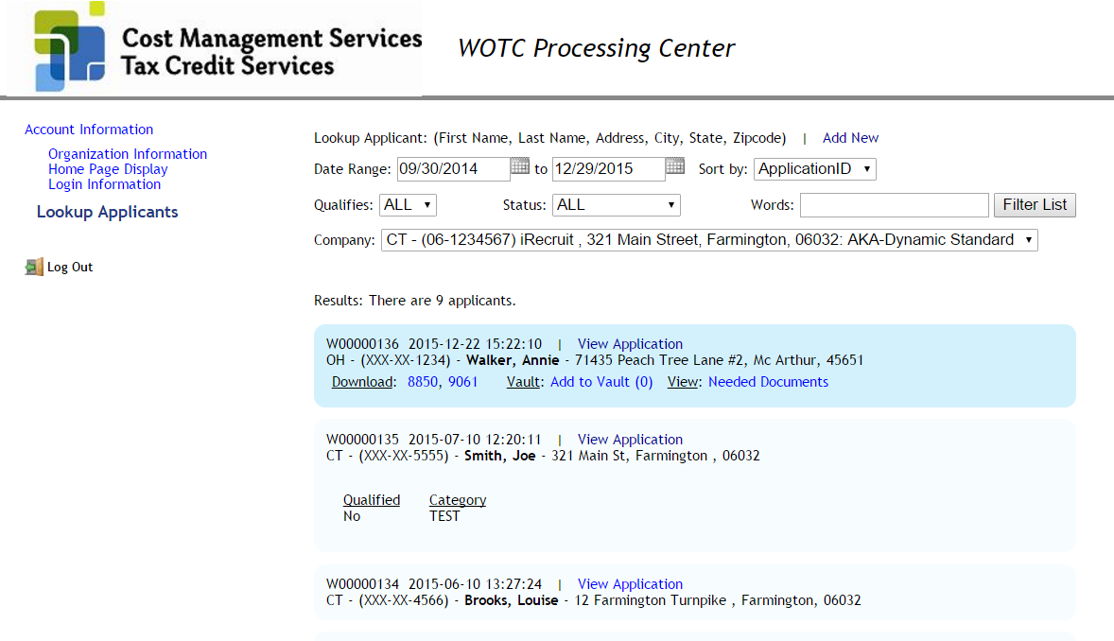
CMS WOTC Administration
Real-Time Results

Slide 33
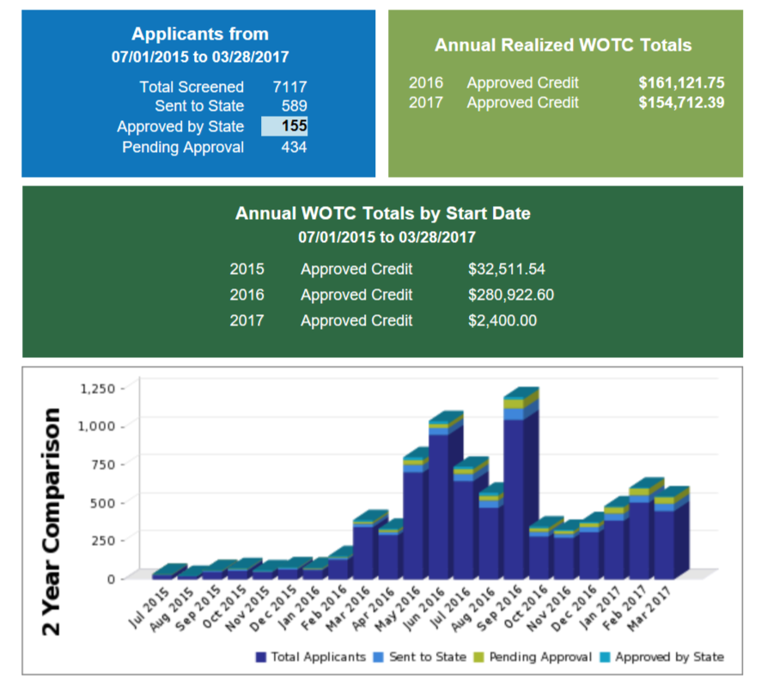
CMS WOTC Dashboard
Real-Time Results

Slide 34
CMS Technology

Slide 35
Work Opportunity Tax Credit
WOTC, is an incentive for employers that hire veterans, the disabled, ex-inmates, SNAP (food stamp) recipients and individuals receiving Supplemental Security Income.
The tax credit ranges from $1,000 -$9,600 depending on the eligibility category of each new hire.
10-15% of New Hires Qualify

Slide 36
What Is Your Company’s Savings?
Number of Employees | 250
Number of New Hires/Per Year | 100
Qualifying Ratio | 15%
Qualifying New Hires | 15
Average Tax Credit | 2,400.00
Employers Savings | $36,000.00
10-15% of New Hires Qualify

Slide 37
Questions?
How to get started:
Signed Client Agreement & POA (s)
Legal Name, Address & EIN
List of addresses for each location
Main contact(s) name and email/phone
Schedule Kick Off Meeting
Brian Kelly
bkelly@cmswotc.com
860-269-0958

